Slide 1
Autonomous Car

Slide 2
-Project idea
a self-driving Car that can avoid the obstacles

Slide 3
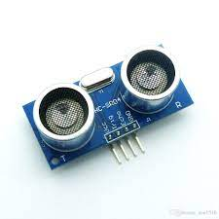
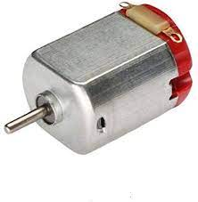
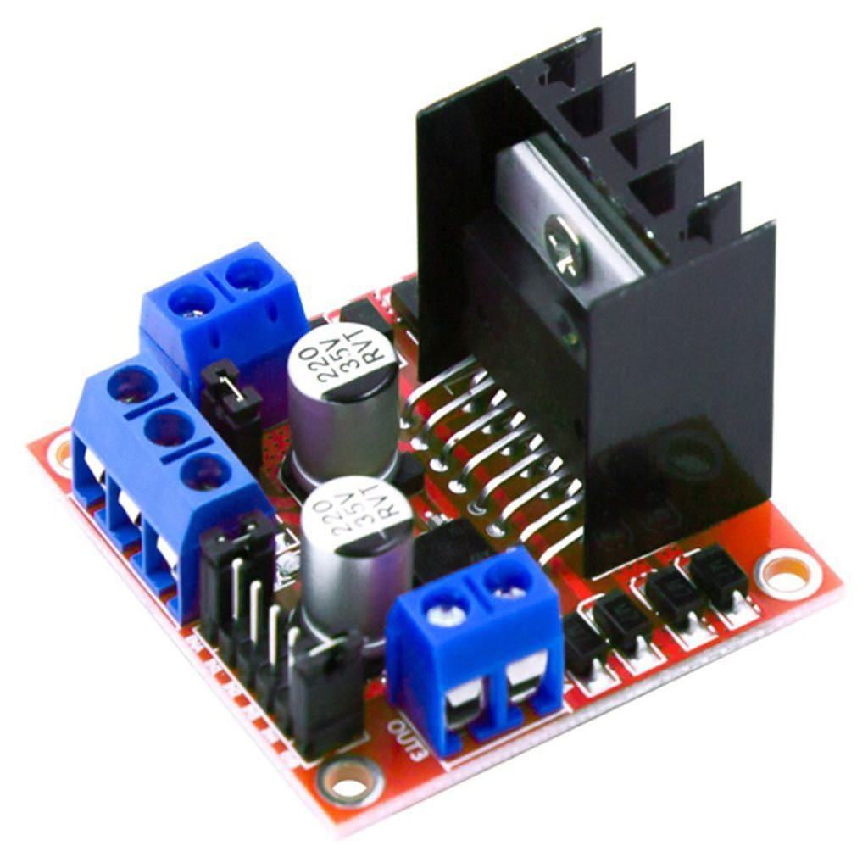
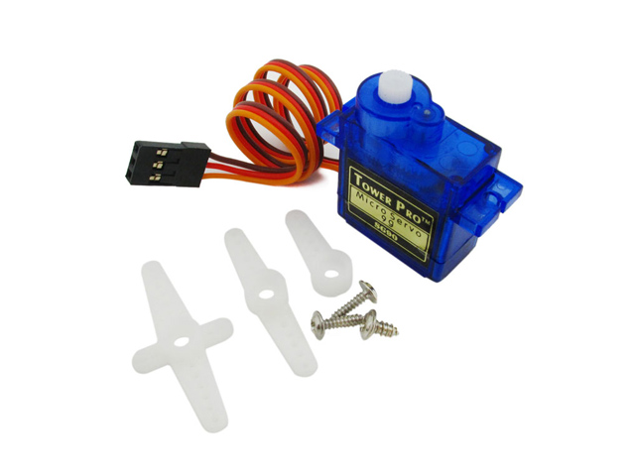
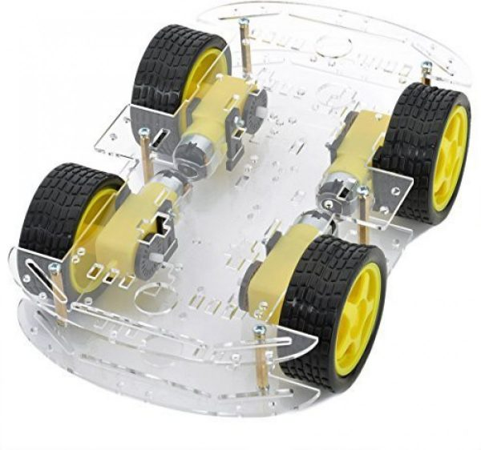
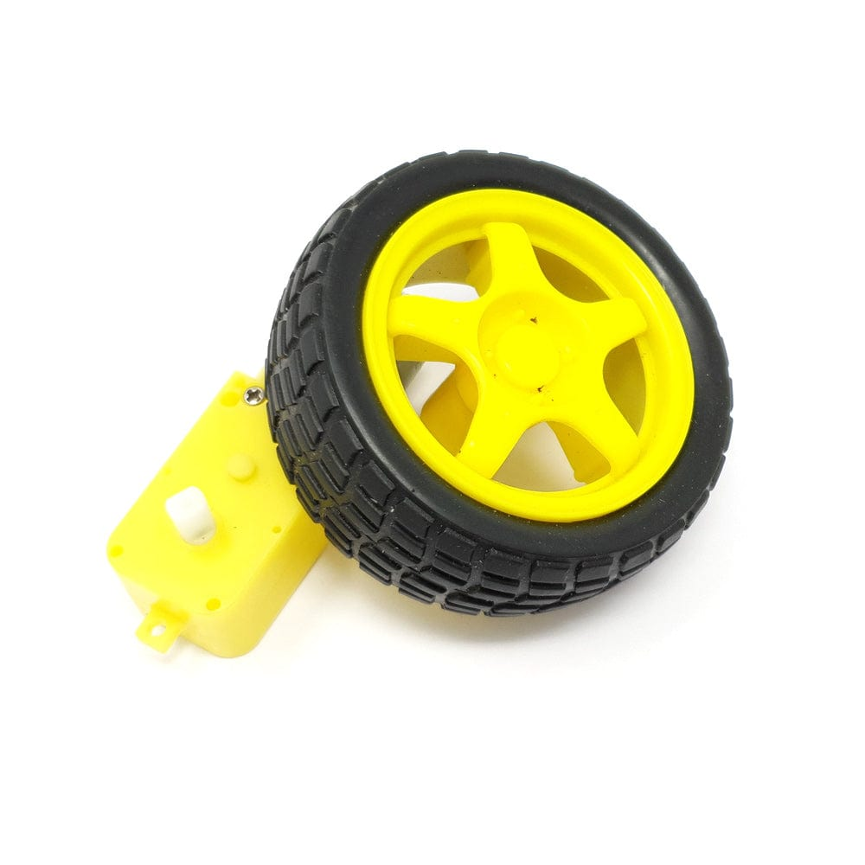
Used components
1. Ultrasonic HC- SR04.
2. Servo motor.
3. l298n .
4. Motors.
5.wheels
6. Chassis

Slide 4
-Function:
1. Ultrasonic is used to detect any obstacles towards to the car, and the car must fast react to avoid this obstacle like stopping and turning to any empty direction.
2. L293D is used to control the speed and the direction of motors.
3. LCD displays the current direction that car immediately move.
4. Servo is used to make ultrasonic scanning around 180°.

Slide 5
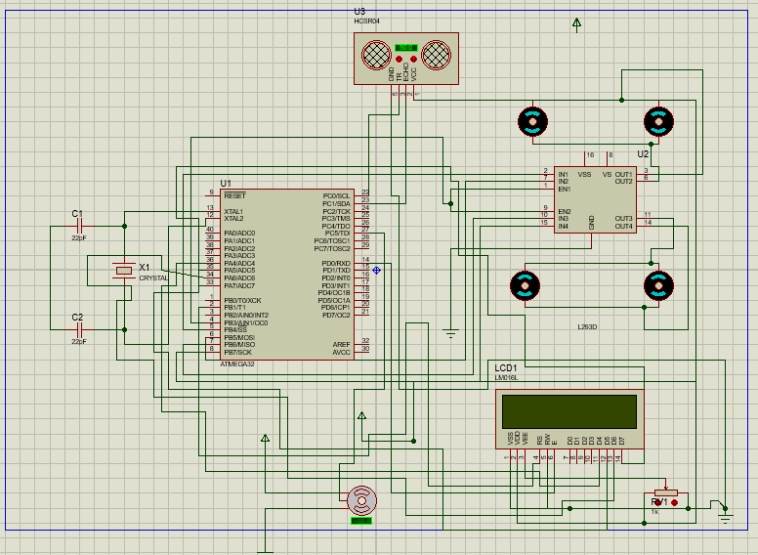
Schem.

